Slide 1
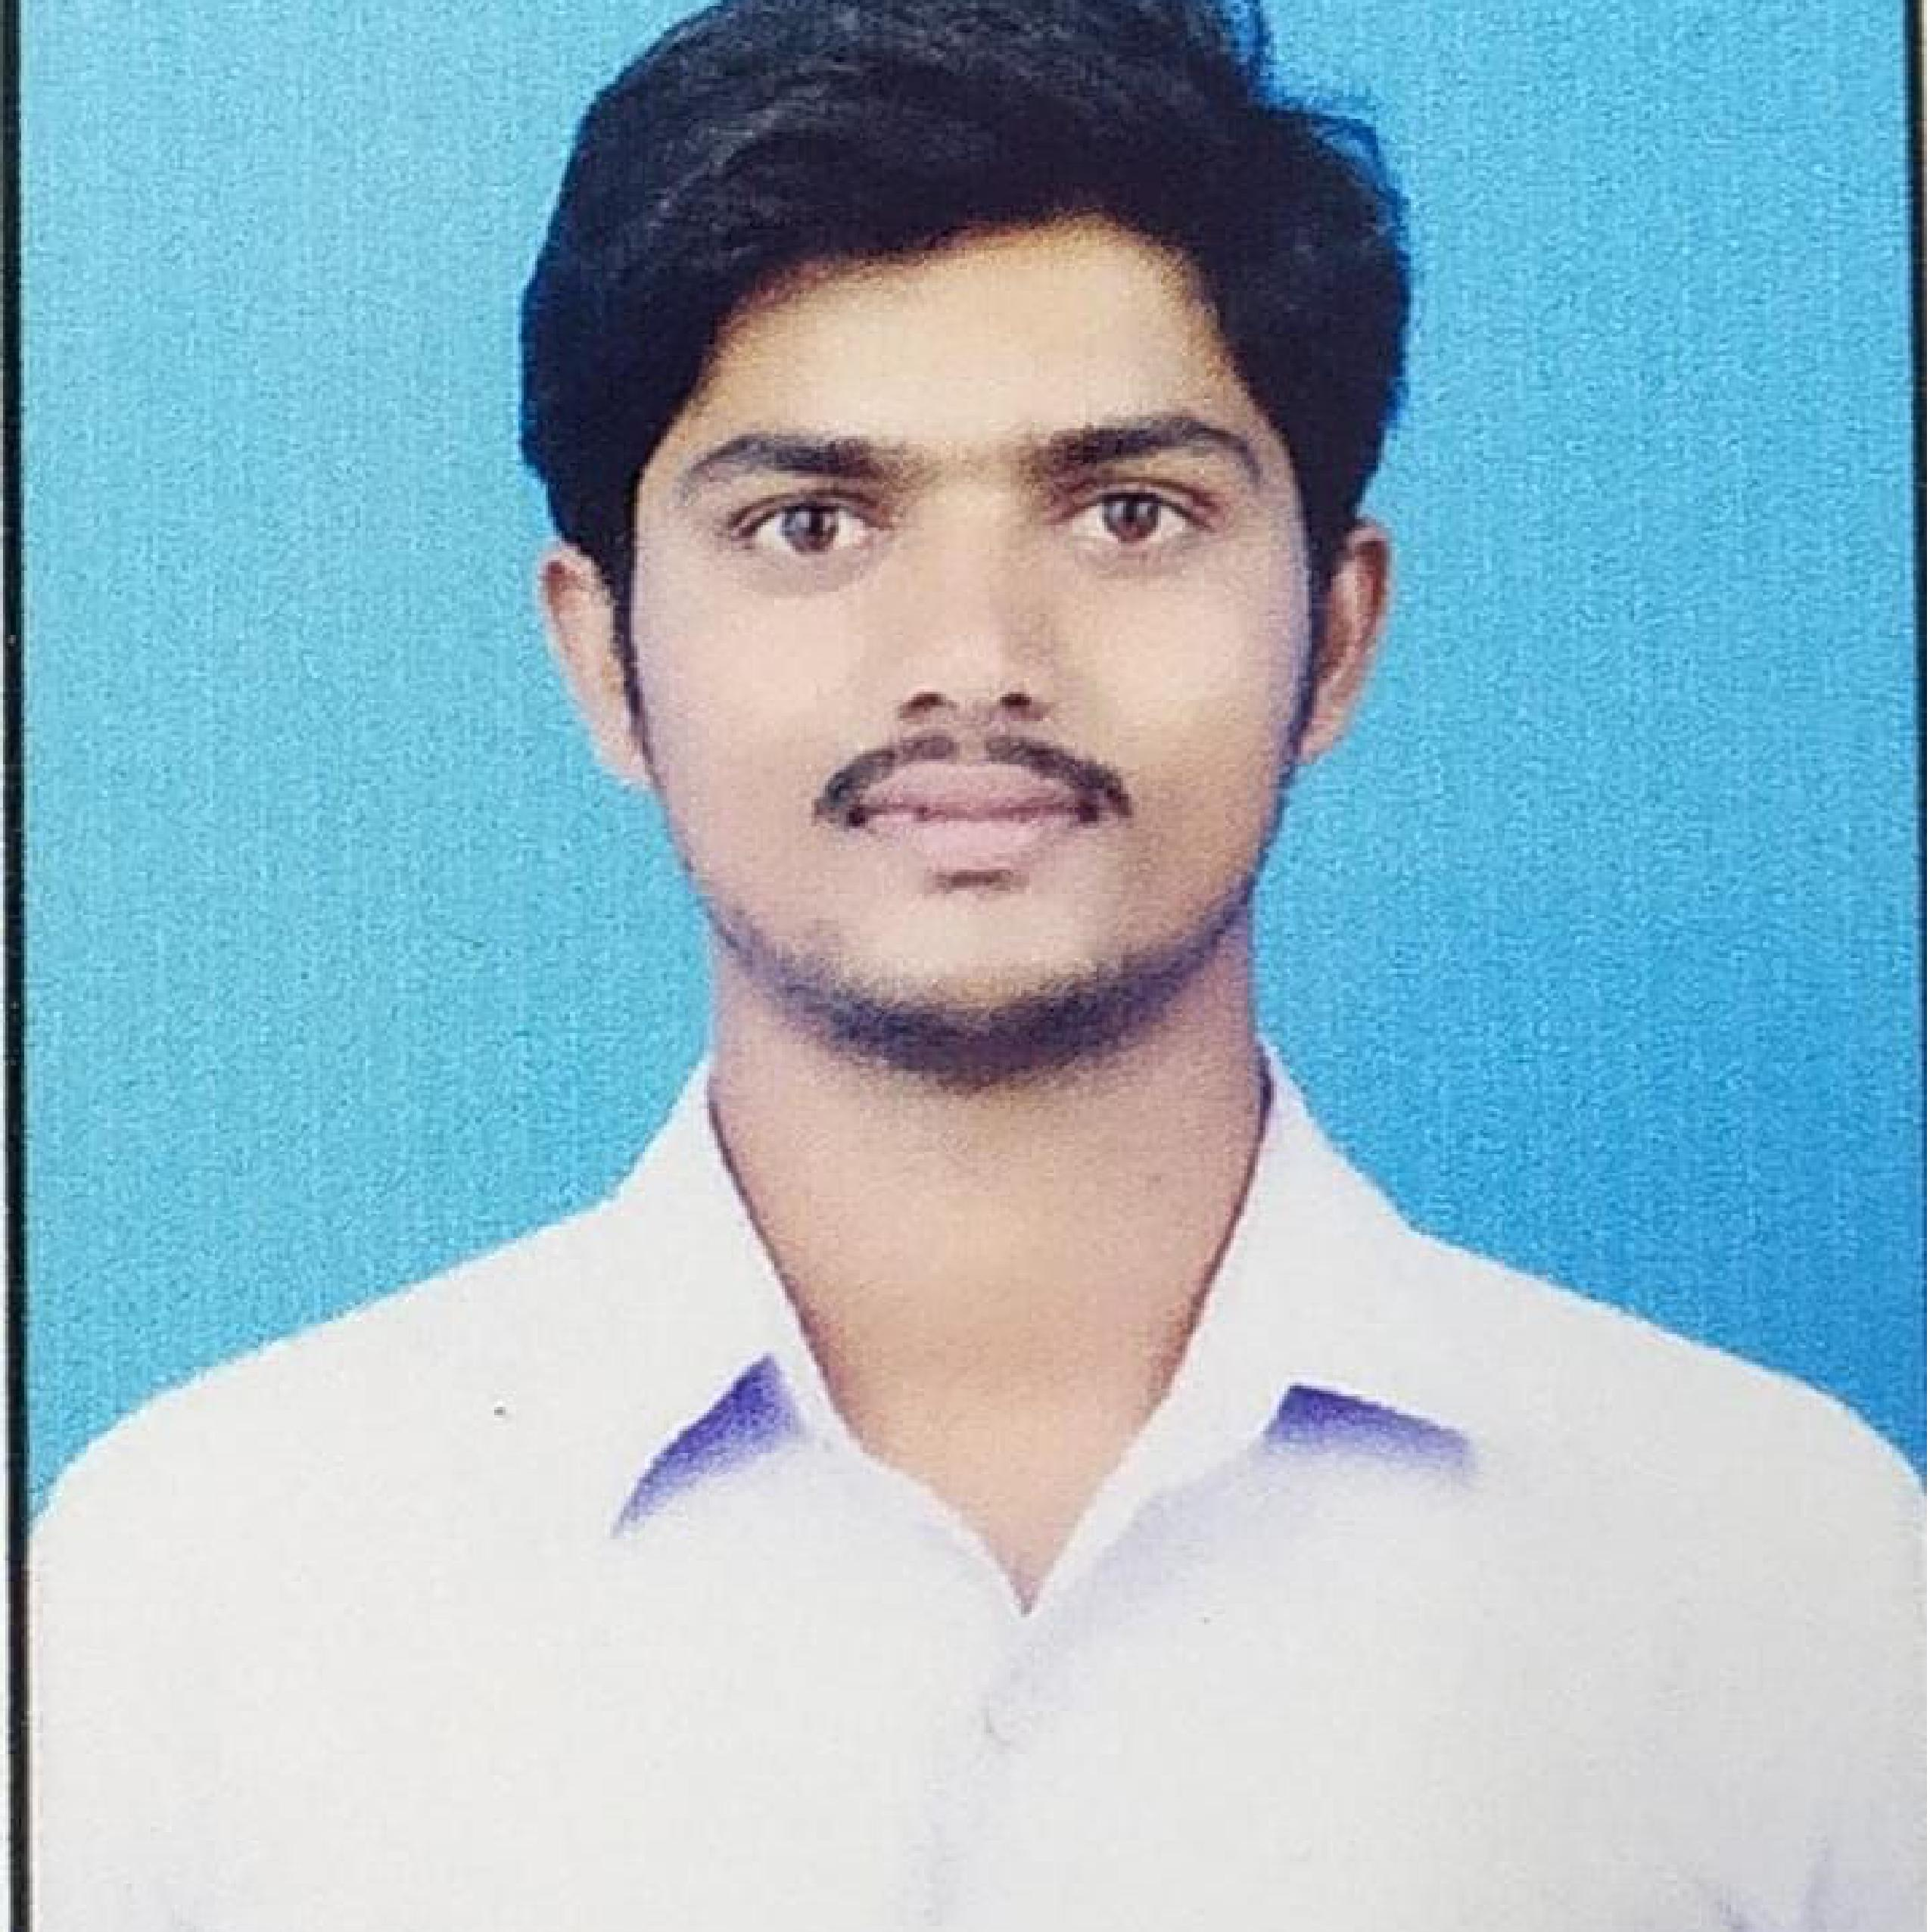



S VENKATESH NAIK
Analyst/Software Engineer
Bachelor of Technology : 2016 - 2020
Skills
Java 8 /J2EE | Java Basics, OOPS, Generics, Collections, Arrays, Loops, Lambda Exp, Stream API Junit, Mockito, Servlets
Spring core | IOC & Dependency Injection, Autowire
Spring REST | REST controllers, Implementation of GET, POST, PUT & DELETE, Bean Validation & Exception Handling, Testing Services, Controller & Repository layer
Spring Data JPA | Implement DAO layer using spring Data repositories, Transaction Management
Spring Boot Microservices | Spring Boot Starters, annotations, Messaging Service, Sync/Async comms, Swagger API documents
Spring Cloud | Eureka, Netflix Ribbon, Netflix Hystrix, Netflix Zuul & Config Server
Angular | Components,Directives,Pipes & Services Working with HTTP,Routing in Angular
Database | MongoDB No SQL Basics
UI Tech | HTML 5 & CSS 3,JavaScript, ES6 & TypeScript, Angular
Tools | Git, Postman, Maven, IDE
Add On skills | Communications, Team management. Peer learning
Bangalore
Venkateshnaik.sabavath@capgemini.com
+918121702926
A4
Full Stack Developer
Hands on experience in creating microservices with Springboot, Spring Security, Spring Cloud API Gateway, Eureka server.
Proficient Angular developer with working knowledge on AngularJS.​
Hands on experience in implementing polyglot architecture with NodeJs & spring boot
Experience in creating documentation with Java docs and swagger and in unit testing using Junit, Mockito.
In-depth understanding of deploying spring boot applications.
On-Demand Car Wash System
Completed end to end case study of On-Demand Car Wash System along with JWT authentication, Swagger and payment and Angular used for user interface.
Completed “Java Full Stack with Angular” From Capgemini.
Completed “Oracle Certified Foundations Associate”
Check out my work on GitHub & Video Profile

